Slide 1

Building a Web Test Plan
Building a Web Test Plan for any website in JMeter
Prepared By: Hadi Mohammed

Slide 2
Building a Web Test Plan
Basic Test Plan in JMeter
To create a basic Test Plan to test any web site, create five users that send requests to two pages on a website. Also, run the tests twice.
So, the total number of users (5 users) x (2 requests) x (repeat 2 times) = 20 HTTP requests.
To construct the Test Plan, we use the following elements:
Thread Group
HTTP Request
HTTP Request Defaults
Graph Results.

Slide 3
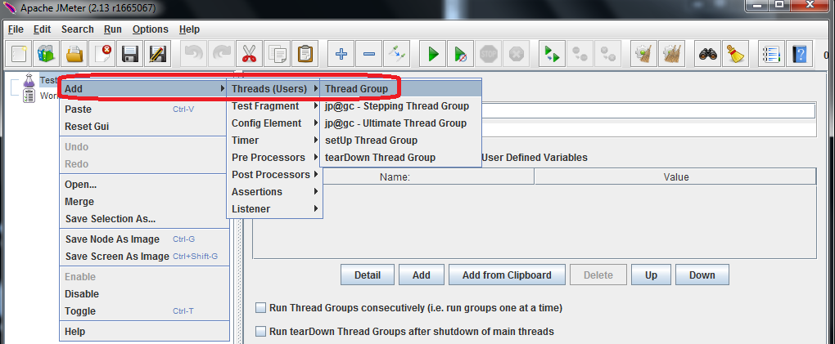
Building a Web Test Plan

Slide 4
Building a Web Test Plan
Thread Group
Thread group is the basic and important element of any JMeter test plan, all controllers and samplers must be under a thread group.
The controls for a thread group allows to:
Set the number of threads
Set the ramp-up period
Set the number of times to execute the test

Slide 5
Building a Web Test Plan
No. of threads configuration
1) No. of Threads specify the no. of virtual users to be emulated on the server.

Slide 6
Building a Web Test Plan
Ramp-Up time configuration
2) Ramp-up Time specifies the time taken by JMeter to make all the specified threads up and running.

Slide 7
Building a Web Test Plan
No. of loops configuration
3) No. of loops specify the number of times that JMeter executes the test.

Slide 8
Building a Web Test Plan
Thread Group configuration

Slide 9
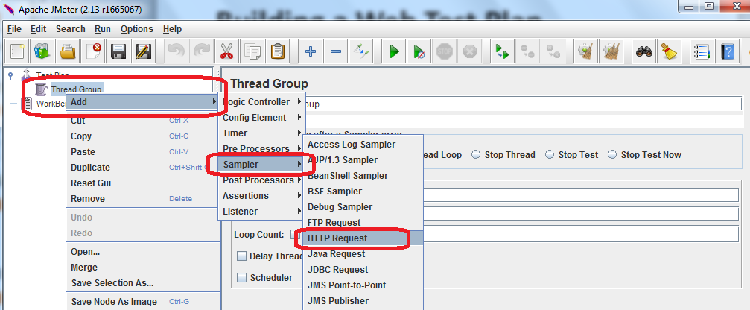
Building a Web Test Plan
Adding HTTP Request

Slide 10
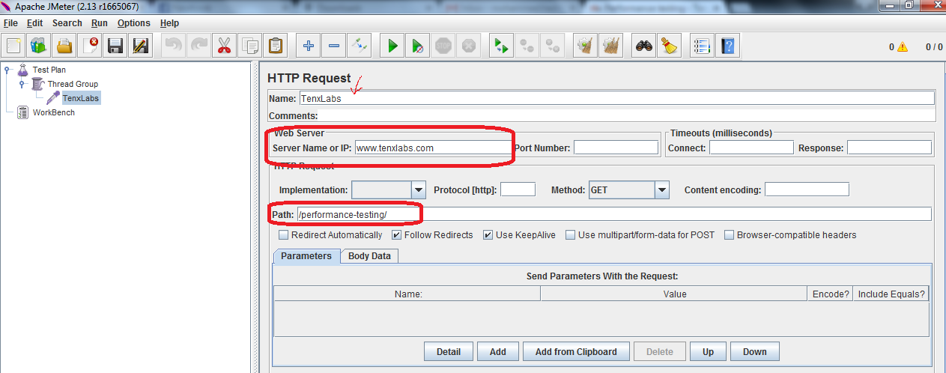
Building a Web Test Plan
HTTP Request configuration

Slide 11
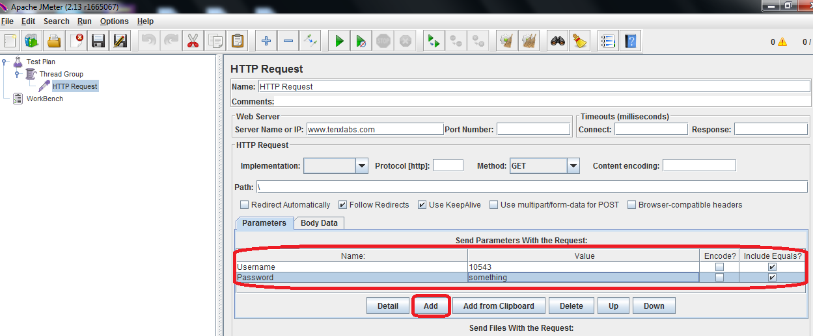
Building a Web Test Plan
Setting parameters and their values

Slide 12
Building a Web Test Plan
Embedded resources - HTTP Request
HTTP Request sampler send an HTTP/HTTPS request to a web server. It also controls whether or not J Meter parses HTML files for images and other embedded resources and sends HTTP requests to retrieve them.
The following types of embedded resource are retrieved:
images
applets
style sheets
external scripts
frames, i frames
background images (body, table, TD, TR)
background sound

Slide 13
Building a Web Test Plan
IDE Features
HTTP Request defaults is a Config element which is used to set default configuration and all the related http requests which hit the same server inherits field values from it.

Slide 14
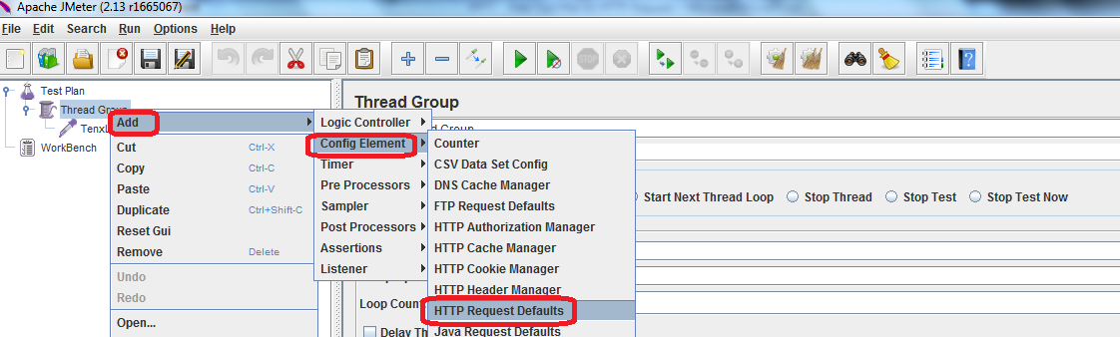
Building a Web Test Plan
HTTP Request defaults

Slide 15
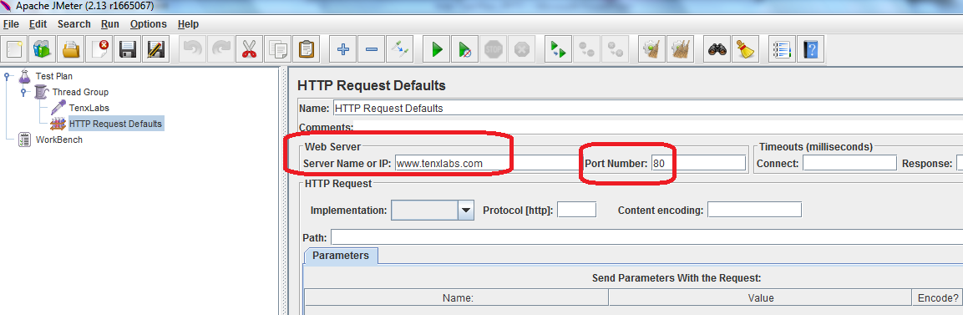
Building a Web Test Plan
HTTP Request defaults configuration

Slide 16
Building a Web Test Plan
HTTP Request defaults
This element set default values that HTTP Request samplers use. For example, if you are creating a Test Plan with 25 HTTP Request samplers and all of the requests are being sent to the same server, you could add a single HTTP Request Defaults element with the "Server Name or IP" field filled in and path if it is applicable.
Then, when you add the 25 HTTP Request samplers, leave the "Server Name or IP" field empty. The controllers will inherit this field value from the HTTP Request Defaults element.

Slide 17
Building a Web Test Plan
Graph Results listener
Graph Results is one of the listeners which is used to display the test results in a graph.

Slide 18
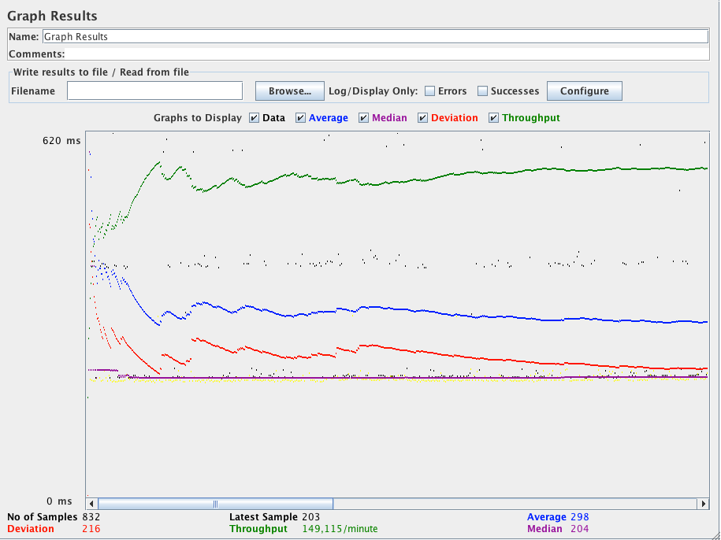
Building a Web Test Plan
Graph Results

Slide 19
Building a Web Test Plan
Graph Results listener
The throughput number represents the actual number of requests/minute the server handled. This calculation includes any delays added to test and J Meter's own internal processing time.
The advantage of doing the calculation is that this number represents something real - server in fact handled that many requests per minute, can increase the number of threads and/or decrease the delays to discover server's maximum throughput.

Slide 20

Thank You

